Slide 2
Who could detox?
Do you...
eat processed foods
drink alcohol
smoke
not get enough sleep
experience stress
need more energy
want to feel better
have exposure to chemicals (at work, prescription medications, etc.)
want to lose weight

Slide 3
What is a toxin?
Toxins are harmful substances that build up in our bodies over time through:
The air we breathe
The foods we eat
The stress we put our bodies under on a daily basis
The body needs to be periodically cleansed of these toxins

Slide 4
Detoxification
Detoxification is the process of removing harmful substances from the body.
External Toxins:
Food Additives
Pesticides
Chemicals
Tobacco Products
Pollution
Internal Toxins:
Bodily Waste
Digestive Process
Energy Production
Hormone Synthesis
Stress

Slide 5
Toxic Overload
We live in a world filled with an abundance of toxic chemicals
Unfortunately, the over abundance of toxins builds up in our bodies causing undue stress
In many instances the liver, gallbladder, kidneys and digestive system can’t keep up with the demand placed on them
People struggle with weight loss when their bodies are filled with toxins

Slide 6
Toxic Overload
Over a period of time, if toxins are not removed, it may adversely affect your health
Like any filter, the liver and it’s supporting detox organs need to be cleansed regularly
A build up of toxins without sufficient detoxification support may lead to an increased toxic burden

Slide 7
What puts you at risk?
Dietary Factors
Sugar
Alcohol
Processed foods
Environmental Exposure
Chemicals
Smoke
Pollution

Slide 8
What puts you at risk?
High Stress Lifestyle
Increased demand on recovery
Lifestyle Factors
Lack of sleep
Lack of physical activity
Excess weight

Slide 9
Manage Toxins Naturally
Diet
Eat a diet rich in color, healthy fats, and lean protein
Stay hydrated with filtered water, not sugary drinks
Exercise & lifestyle & Sleep
Support circulation and digestion with regular movement & adequate sleep
Make sure you take steps to get a good nights sleep
Supplementation
Notes:
We all do this daily, right?

Slide 10
What does
detoxification
actually mean?

Slide 11
Reasons For Detoxing & Cleansing
Remove Toxins from the Body
Prevent Chronic Disease
Enhance Immune System
Slow Premature Aging
Improve Quality of Life
Notes:
We all do this daily, right?

Slide 12
Reasons For Detoxing & Cleansing
Increase Energy
Improve Skin Quality
Mental & Emotional Clarity
Restore Balance to your Body’s Systems
Lose Weight / Kick Starting a Weight Loss Program
Notes:
We all do this daily, right?

Slide 13
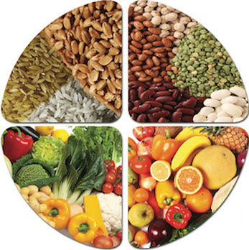
WHY the lack of protein?
Fruits
Vegetables
Whole grains
Seeds
NO PROTEIN
Notes:
We all do this daily, right?

Slide 14
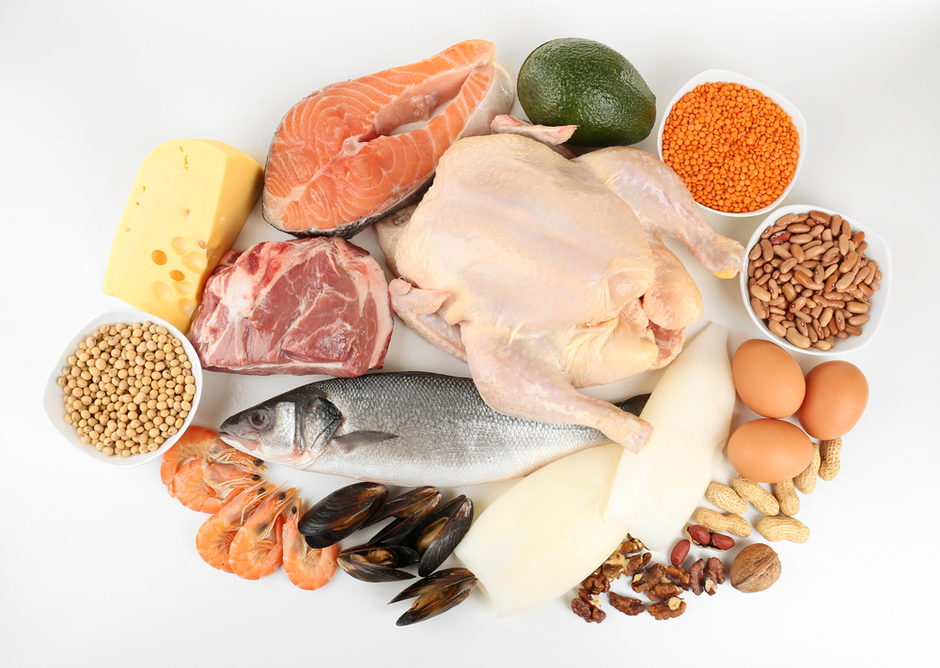
The Reality of Protein
Repair
Renew
Improve
We need protein to do these!
Notes:
We all do this daily, right?

Slide 15
The
Science
of
Detoxification

Slide 16
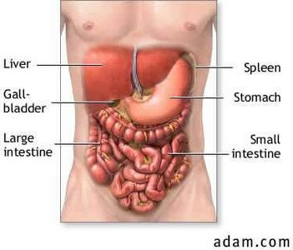
A healthy digestive tract, gallbladder and kidneys are essential for your liver to complete its goal for effective detoxification.
The Liver is the #1 detox organ in the body!
Notes:
We all do this daily, right?

Slide 17
Gastro-Intestinal Function
The GI Tract is not just a piece of plumbing. It is an active organ involved in:
Immunity
An active barrier between you and the outside world; a combination of immune tissue and healthy micro-flora (bacteria)
Excretion
The intestine finishes the process of digestion and absorption of nutrients and passes unwanted material through for elimination.

Slide 19
Phases of Detoxification
Phase I
Oxidation
Phase II
Conjugation
Definition: In phase 1, the liver uses oxygen and enzymes to burn toxins. This process is called Oxidation, and makes the toxins more soluble in water, making them more easily excreted from the body (from liver or kidneys).
Definition: To rid the body of toxins
produced by phase 1, the liver performs
phase 2 conjugation. In this phase, the
oxidized chemicals are combines with sulfur, amino acids, excreted in bile.

Slide 20
Phase II Detoxification
Sulfur
Food Sources
Amino Acids
Cysteine
Methionine
Bioflavonoids
Fruit
Vegetables
Oils

Slide 21
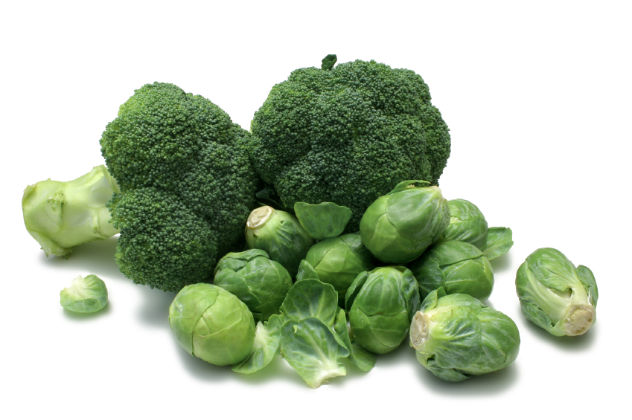
Phase II liver Detoxification Helpers:
Adequate protein intake
Alliums such as onions and scallions
Citrus fruit
Curcumin
Cruciferous vegetables such as cabbage, broccoli, brussels sprouts

Slide 22
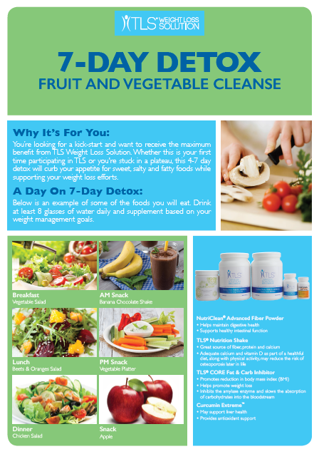

Slide 23
The Basics
Two – three ounce servings of protein daily
Two servings of healthy oils daily
Eat three fruits daily
Eat at least 8-12 cups of vegetables daily

Slide 24
Detox Re-Caps
Alcohol
Coffee, Soda, Caffeinated Beverages
No Grains or Starches
Sugar - (other than natural sugar found in fruits) or junk food
Strenuous Exercise
Skipping Meals
NO...

Slide 25
Detox Re-Caps
Drink 8-10 cups of water daily
Start each day with ½ fresh lemon squeezed into a cup of warm water
Get plenty of rest & sleep
Use spices
Chose raw or slightly steamed vegetables
Use TLS supplements and other detox support products

Slide 26
Why lemon juice and warm water?
Helps the gall bladder work effectively
Helps flush the toxins out
Helps with cravings
Helps maintain immune system
The potassium content in lemon helps nourish brain and nerve cells
Lemons contain pectin fiber which is very beneficial for colon health and also serves as a powerful antibacterial
It balances maintain the pH levels in the body
Having warm lemon juice early in the morning helps flush out toxins
It aids digestion and encourages the production of bile

Slide 27
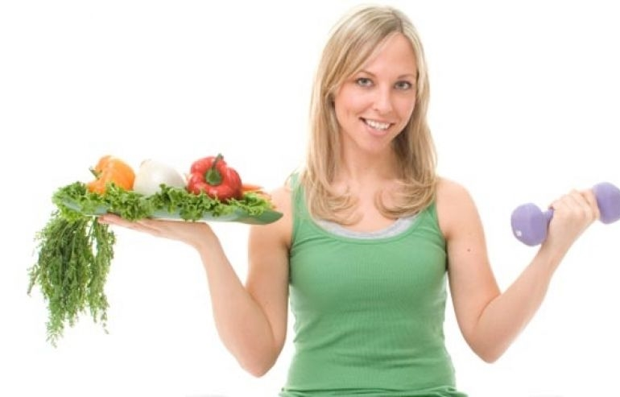
Exercise & Detox
Why should exercise be avoided?
What types of exercise are better options?

Slide 28
Is consuming whole, natural-foods enough?
Consuming a wide variety of natural foods in their freshest and least processed form is still the best practice
HOWEVER:
The quality of your food may be limited by:
Transportation
Storage
Cooking
Irradiation - Microwaving
Handling - Freezing Thawing
Exposure to light and or oxygen

Slide 29
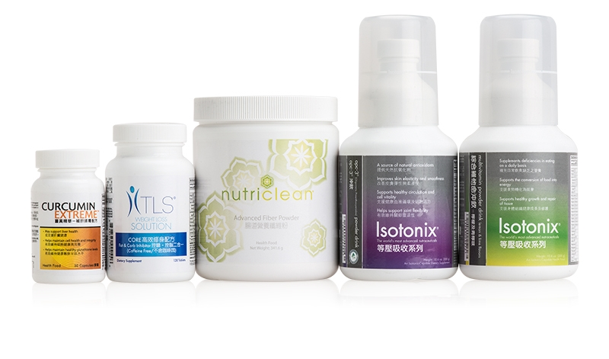
TLS® Detox Support Products

Slide 30
The statements in this presentation have not been evaluated by the FDA. Products or ingredients discussed herein are not intended to diagnose, treat, cure, or prevent any disease.

Slide 31
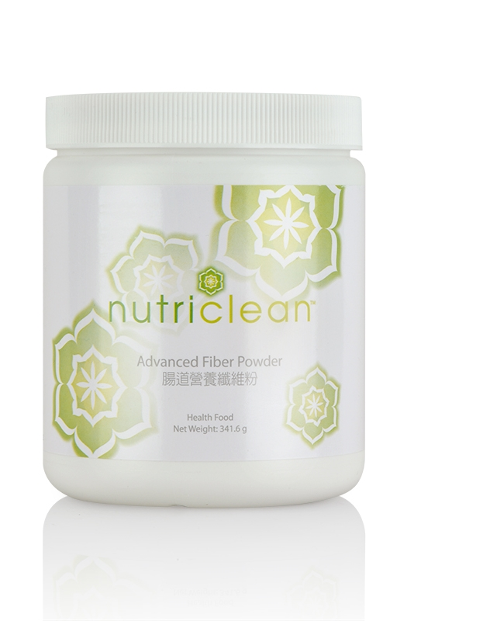
NutriClean® Advanced Fiber Powder
Helps maintain digestive health
Supports healthy intestinal function
Enhances immunity
Helps maintain proper levels of intestinal microflora

Slide 32
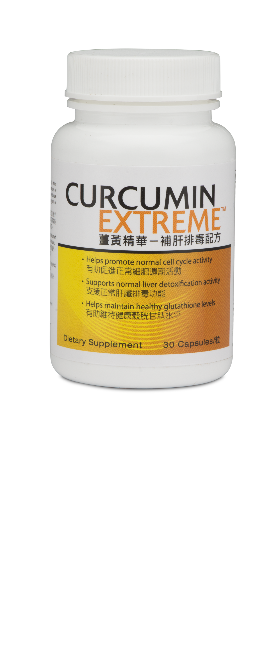
Curcumin Extreme™
May support liver health
Helps maintain cell health and integrity
Helps maintain healthy glutathione levels
Supports cognitive health as we age
Provides antioxidant support

Slide 33
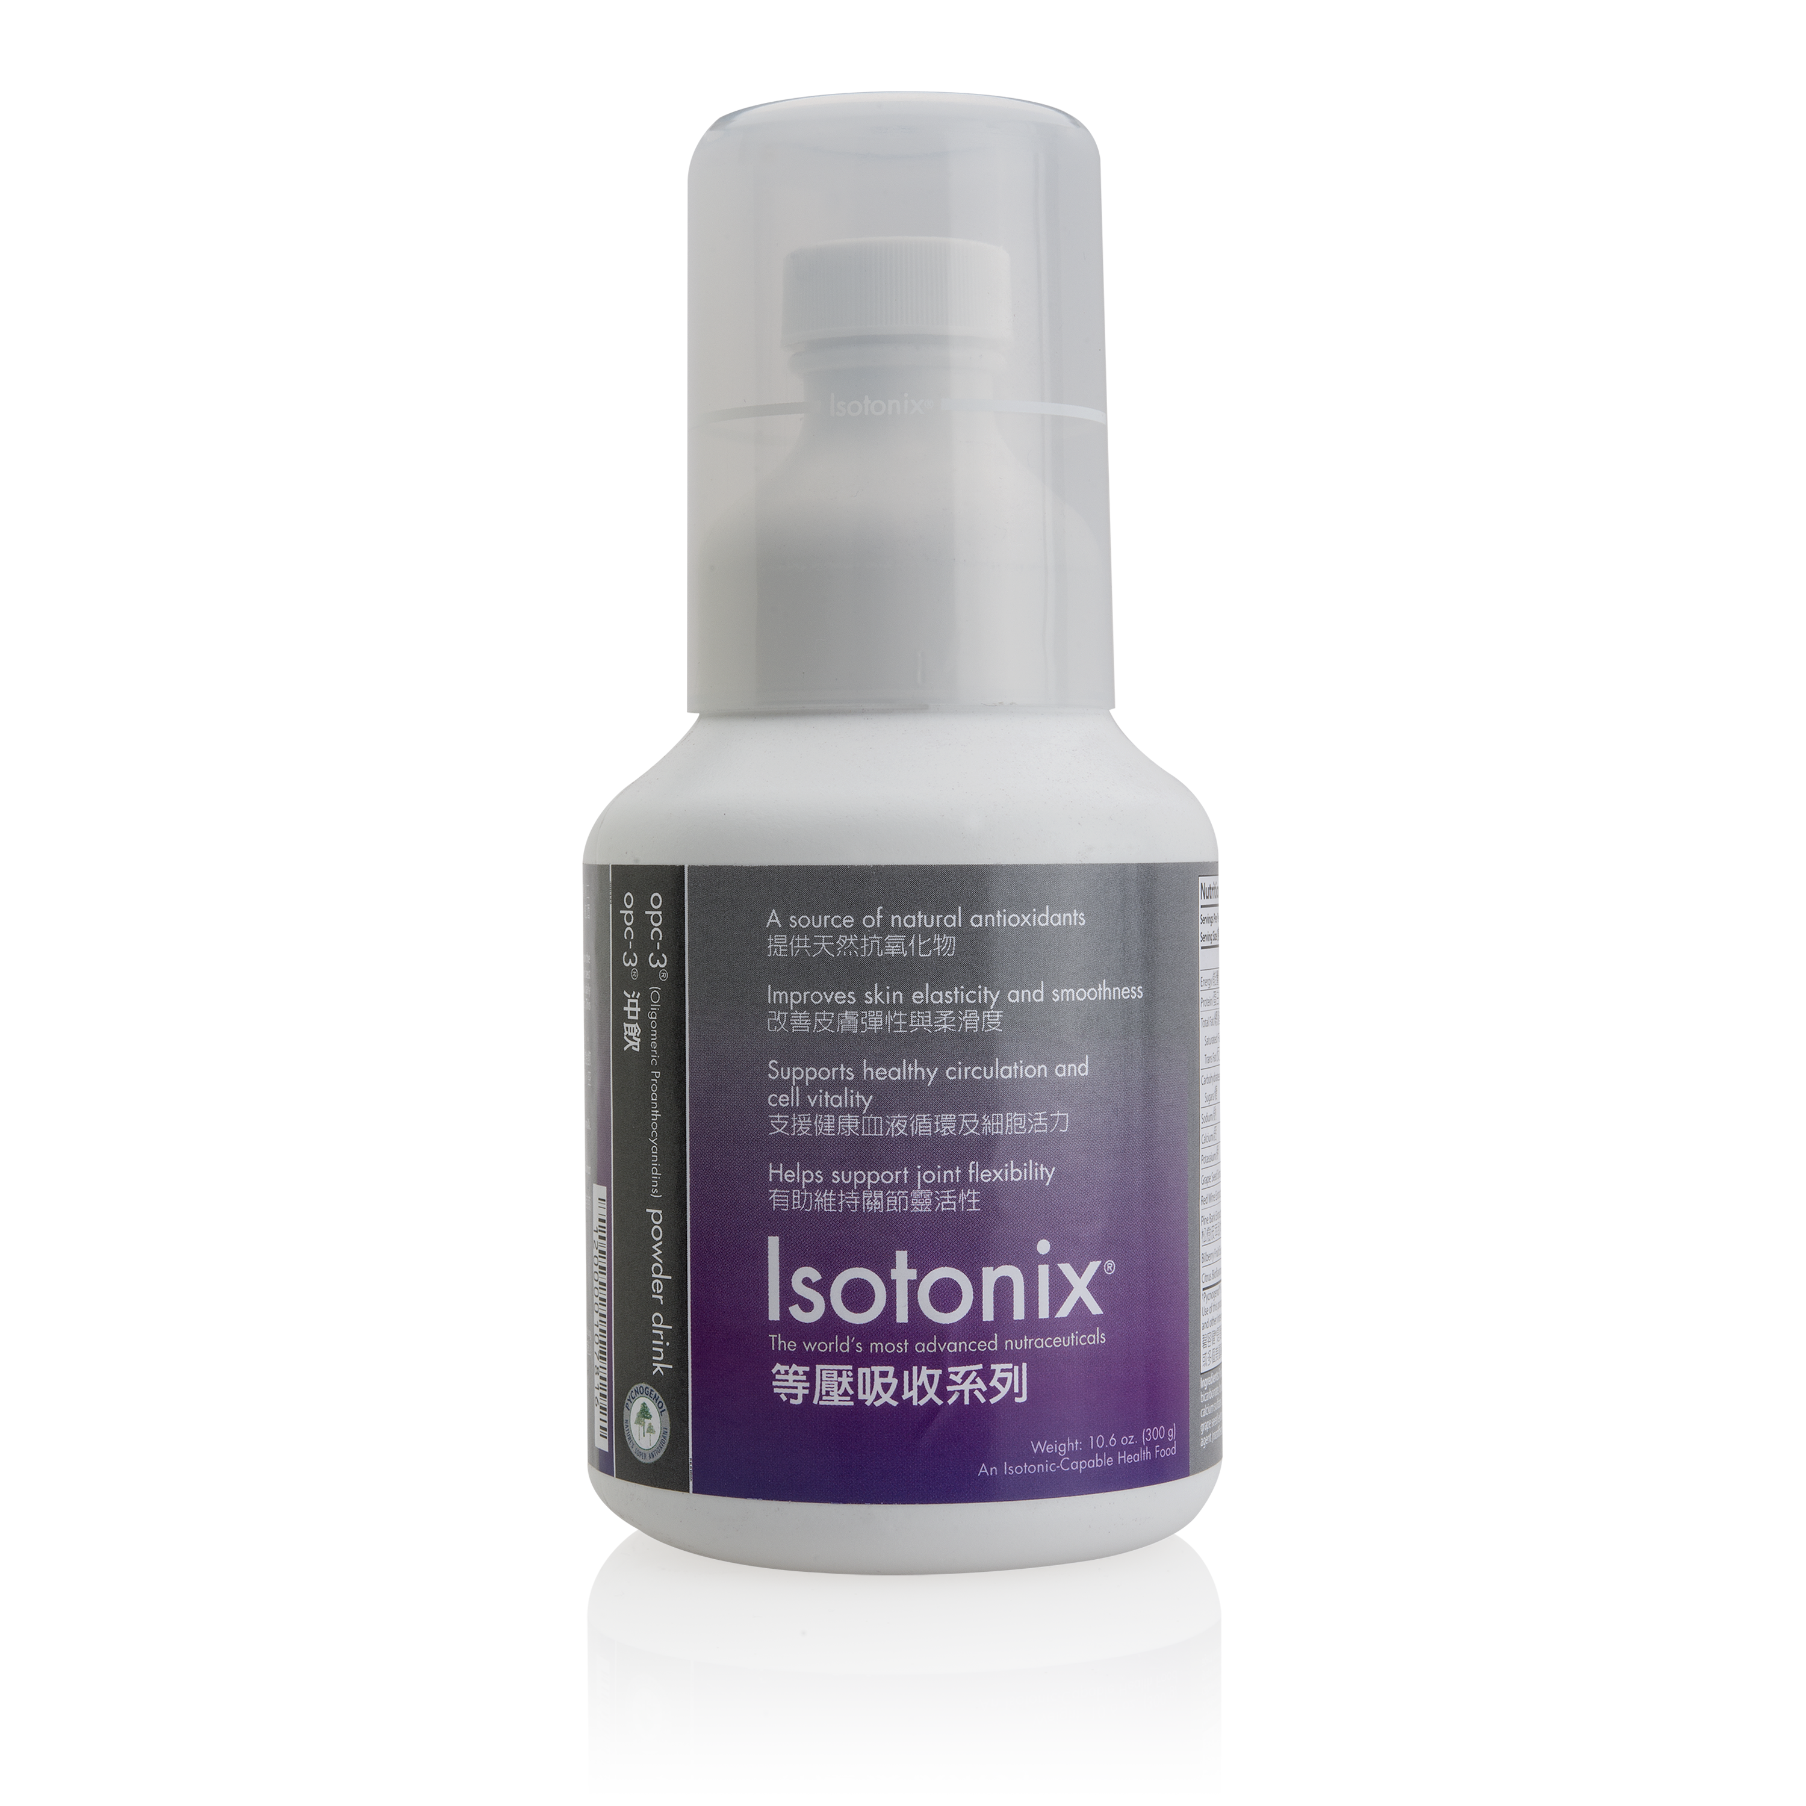
Isotonix OPC-3® Powder Drink
Pycnogenol®
Grape Seed Extract
Red Wine Extract
Bilberry Extract
Citrus Bioflavonoids Complex

Slide 34
Isotonix OPC-3® Powder Drink
A source of natural antioxidants
Improves skin elasticity and smoothness
Supports healthy circulation and cell vitality
Helps maintain vision health
Helps support joint flexibility

Slide 35
Food Quality
Reduction in average mineral content of fruit and vegetables between 1940 and 1999
Mineral | Vegetable | Fruit
Sodium | -49% | -29%
Potassium | -16% | -19%
Magnesium | -24% | -16%
Calcium | -46% | -16%
Iron | -27% | -24%
Copper | -76% | -20%
Zinc | -59% | -27%
Source: Scientific American, “Dirt Poor: Have Fruits and Vegetables Become Less Nutritious?”, Apr 2011
Notes:
http://soils.wisc.edu/facstaff/barak/poster_gallery/minneapolis2000a/ ???? Check this

Slide 36
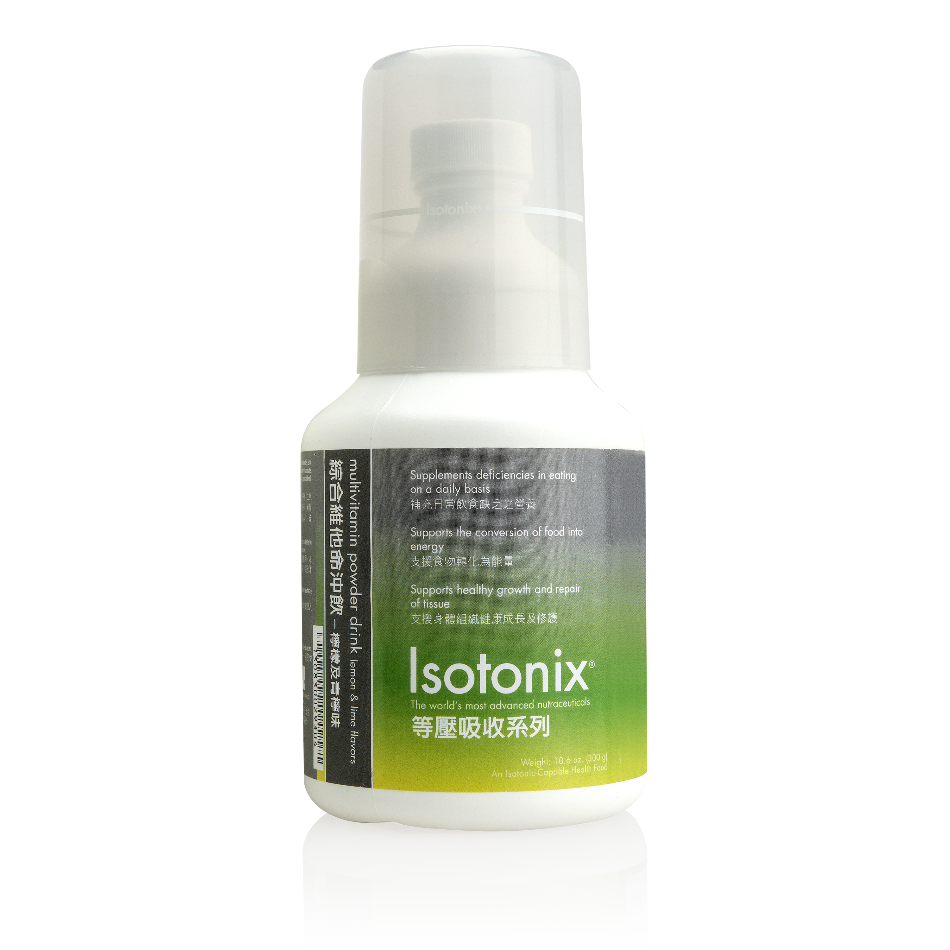
Isotonix® Multivitamin Powder Drink
Supplements deficiencies in eating on a daily basis
Supports the conversion of food into energy
Supports healthy growth and repair of tissue

Slide 37
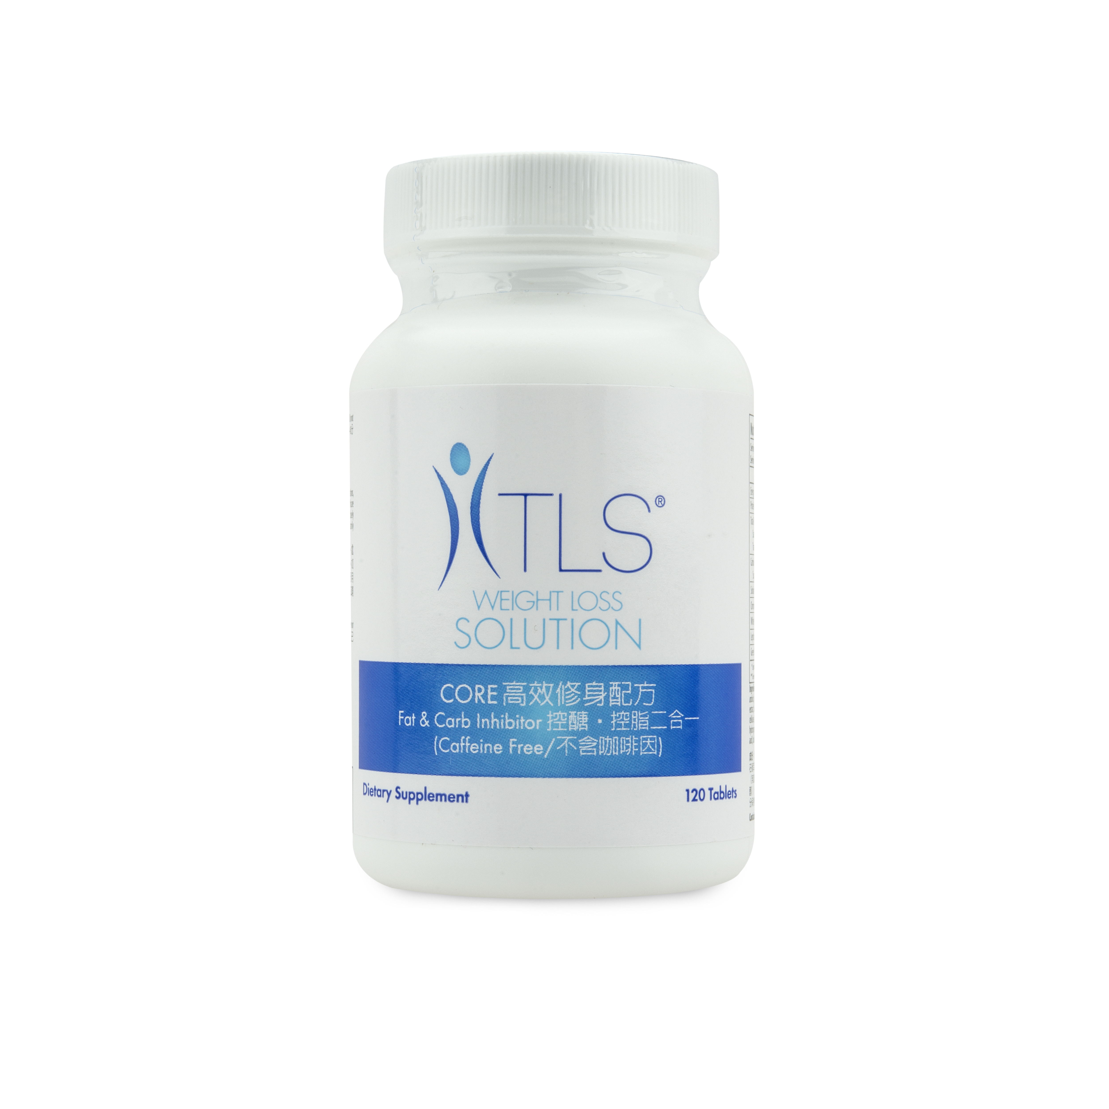
TLS® CORE
Promotes reduction in body mass index (BMI)
Helps promote weight loss
Inhibits the amylase enzyme and slows the
absorption of carbohydrates into the bloodstream
Helps inhibit carbohydrate absorption in the body

Slide 38
TLS® Detox Support Products

Slide 39
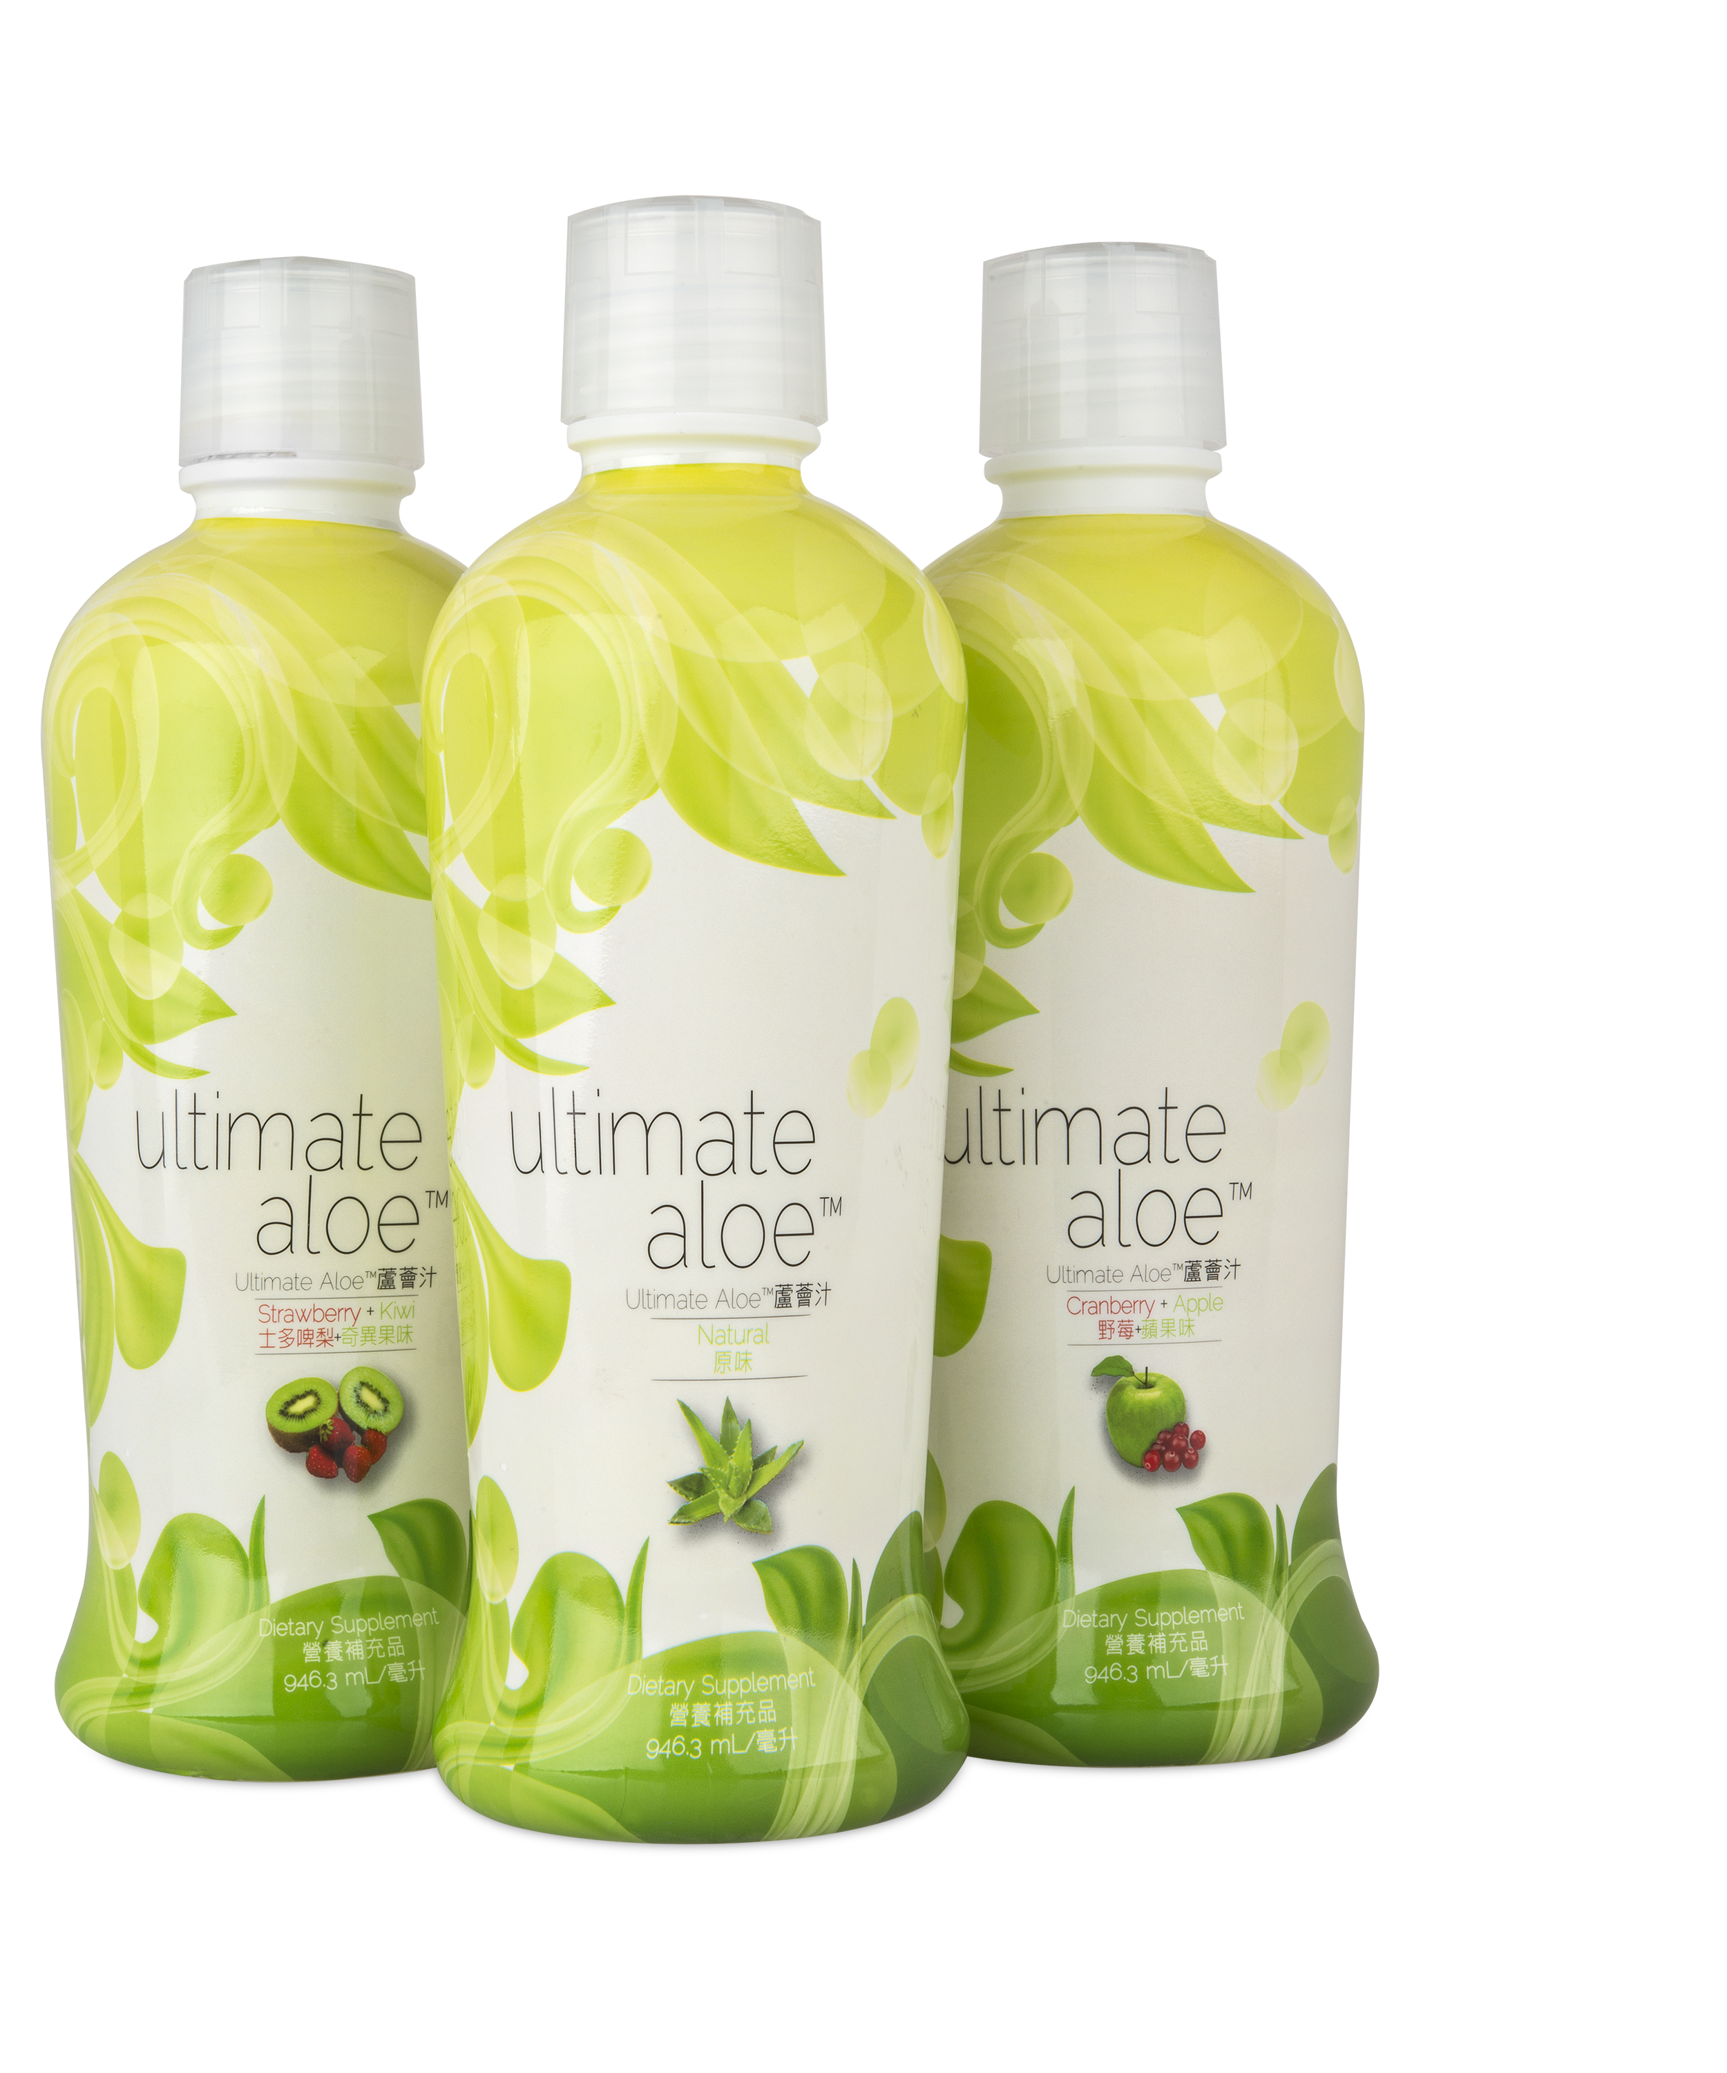
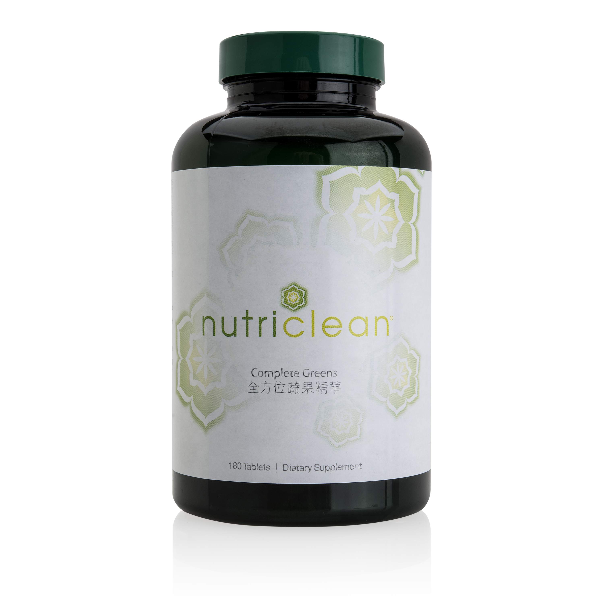
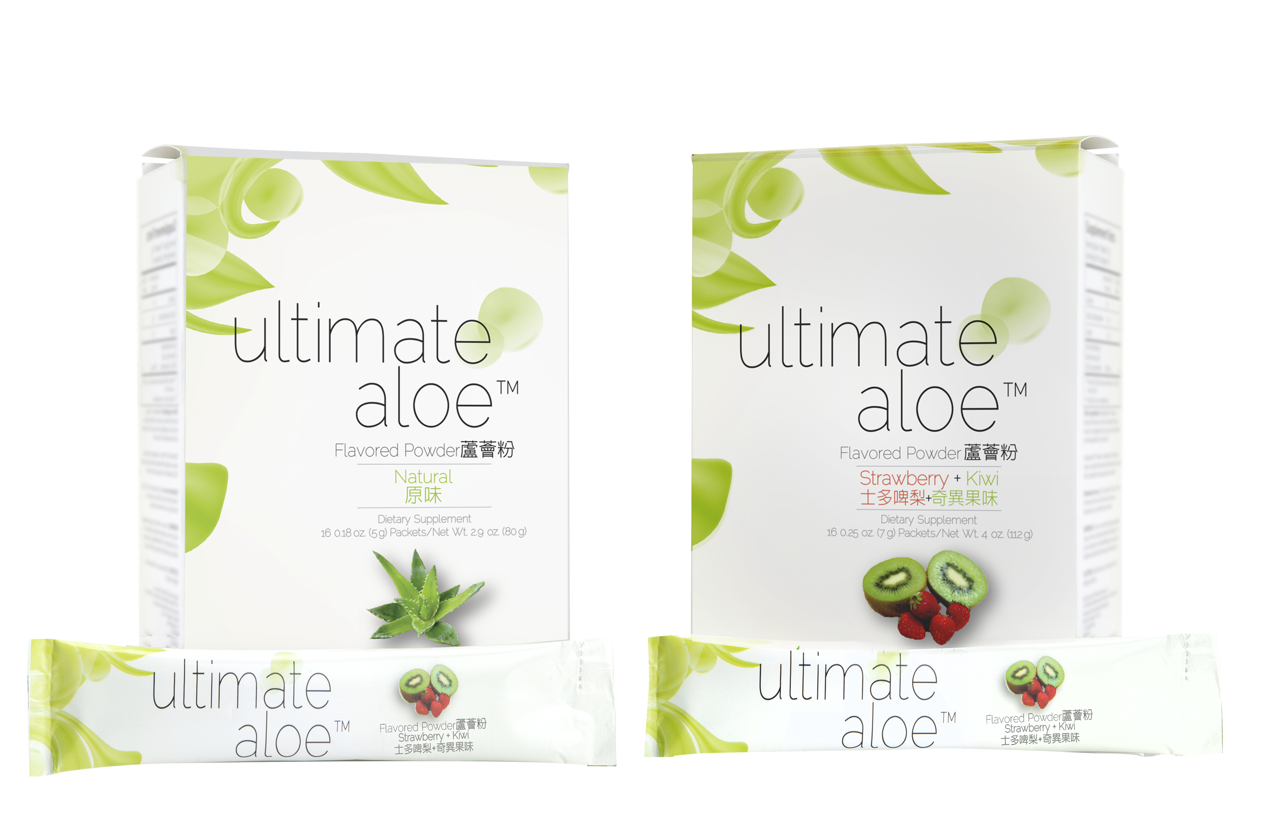
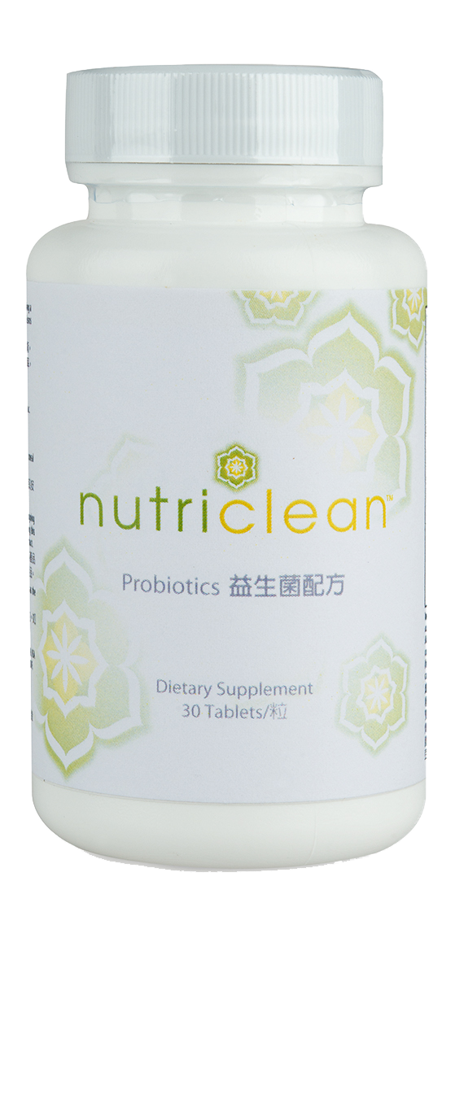
Products Support Digestive Health

Slide 40
TLS® Menu Plan & TLS Detox Support Products
Proteins, vegetables, fruits, oils, proteins coupled with the TLS Detox Support Products allows for a gentle, yet effective cleanse week.
With the CORE, multivitamin, and OPC-3 , your clients get additional support.
Weight loss isn’t magic; it’s science!

